Slide 1



PIZZA SALES DATA ANALYSIS PROJECT USING SQL

Slide 2

OVERVIEW
Project Objective
Analyze pizza sales data to uncover trends and insights that can drive strategic business decisions.
Dataset Overview
The project consists of a pizza sales dataset which has four tables:
Order_details
Orders
Pizza_types
Pizzas
Methodology
Data Collection: SQL queries on sales database.
Data Analysis: Price comparison, order frequency, category analysis.

Slide 3

Retrieve the total number of orders placed?
1
SELECT count(order_id) AS total_orders
FROM orders;

Slide 4

Calculate the total revenue generated from pizza sales.
2
SELECT ROUND(SUM(order_details.quantitypizzas.price)) AS Total_revenue
FROM order_details
JOIN pizzas
ON order_details.pizza_id = pizzas.pizza_id;

Slide 5

Identify the highest-priced pizza.
3
SELECT
pizza_types.name, pizzas.price
FROM pizza_types
JOIN pizzas
ON pizza_types.pizza_type_id = pizzas.pizza_type_id
ORDER BY pizzas.price DESC
LIMIT 1 ;

Slide 6
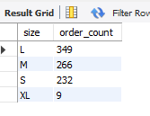
Identify the most common pizza size ordered.
4
SELECT
pizzas.size AS size, COUNT(order_details.order_details_id) AS order_countFROM pizzas
JOIN order_details
ON pizzas.pizza_id = order_details.pizza_id
GROUP By size
ORDER BY order_count DESC;

Slide 7
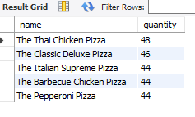
List the top 5 most ordered pizza types along
with their quantities.
5
SELECT pizza_types.name,
SUM(order_details.quantity) as quantity
FROM pizza_types
JOIN pizzas
ON pizzas.pizza_type_id = pizza_types.pizza_type_id
JOIN order_details
ON pizzas.pizza_id = order_details.pizza_id
GROUP BY pizza_types.name
ORDER BY quantity DESC
LIMIT 5;

Slide 8
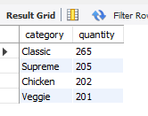
Join the necessary tables to find the total quantity
of each pizza category ordered?
6
SELECT pizza_types.category AS category,
SUM(order_details.quantity) as quantity
FROM pizza_types
JOIN pizzas ON pizzas.pizza_type_id = pizza_types.pizza_type_id
JOIN order_details ON pizzas.pizza_id = order_details.pizza_id
GROUP BY category
order by quantity DESC;

Slide 9
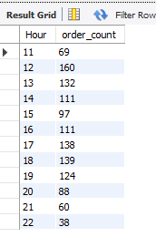
Determine the distribution of orders by hour of the day.
7
SELECT HOUR(time) AS Hour,
COUNT(order_id) AS order_count
FROM orders
GROUP BY Hour;

Slide 10
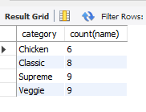
Join relevant tables to find the category-wise
distribution of pizzas.
8
SELECT category,count(name)
pizza_types
group by category;

Slide 11

Group the orders by date and calculate the average
number of pizzas ordered per day.
9
SELECT
round(AVG(quantity),0) AS Avg_Pizza_orders
FROM(
SELECT orders.date ,
SUM(order_details.quantity) as quantity
FROM orders
JOIN order_details ON orders.order_id = order_details.order_id
GROUP BY orders.date) As order_quantity;

Slide 12
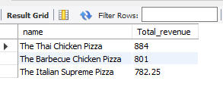
Determine the top 3 most ordered pizza types
based on revenue.
10
SELECT pizza_types.name AS name,
SUM(order_details.quantity * pizzas.price) AS Total_revenue
FROM pizza_types
JOIN pizzas ON pizzas.pizza_type_id = pizza_types.pizza_type_id
JOIN order_details ON order_details.pizza_id = pizzas.pizza_id
GROUP BY name
ORDER BY Total_revenue DESC
LIMIT 3;

Slide 13
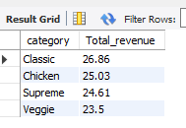
Calculate the percentage contribution of each pizza
type to total revenue
11
SELECT pizza_types.category AS category,
ROUND((SUM(order_details.quantity * pizzas.price)) /
( SELECT ROUND(SUM(order_details.quantity * pizzas.price),2) FROM order_details
JOIN pizzas ON order_details.pizza_id = pizzas.pizza_id) *100,2) AS Total_revenue
FROM pizza_types
JOIN pizzas ON pizzas.pizza_type_id = pizza_types.pizza_type_id
JOIN order_details ON order_details.pizza_id = pizzas.pizza_id
GROUP BY category
ORDER BY Total_revenue DESC;

Slide 14
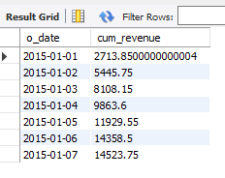
Analyze the cumulative revenue generated over time
12
SELECT o_date,
SUM(revenue) OVER(order by o_date) AS cum_revenue
FROM(SELECT orders.date AS o_date,
SUM(order_details.quantity * pizzas.price) as revenue
FROM order_details
JOIN pizzas ON order_details.pizza_id = pizzas.pizza_id
JOIN orders ON orders.order_id = order_details.order_id
GROUP BY o_date) AS SALES;

Slide 15
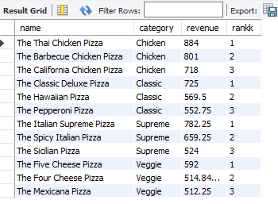
Determine the top 3 most ordered pizza types based on
revenue for each pizza category.
13
SELECT name, category, revenue, rankk
FROM
(SELECT name, category, revenue,
rank() OVER(partition by category order by revenue DESC) AS rankk
FROM
(SELECT pizza_types.name AS name, pizza_types.category AS category, SUM(order_details.quantity * pizzas.price) AS revenue
FROM pizza_types
JOIN pizzas ON pizzas.pizza_type_id = pizza_types.pizza_type_id
JOIN order_details ON order_details.pizza_id = pizzas.pizza_id
GROUP BY name, category) AS a) AS b
where rankk <=3;

Slide 16
THANK YOU
Gmail : shailyk0508@gmail.com

